Slide 1
Computer Networks
What is a network?
Connecting Media
Types of networks
DNS
TCP/IP
Internet

Slide 2
Wireless Networks
What is a Network?
Connecting two or more computers or devices together through a media (cable or wireless)

Slide 3
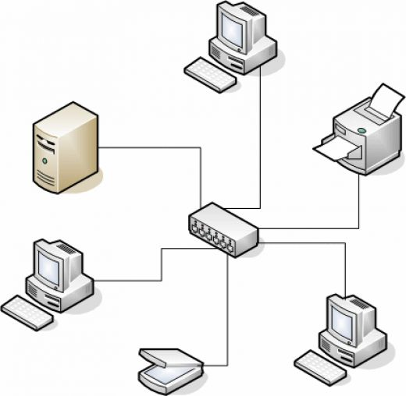
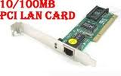
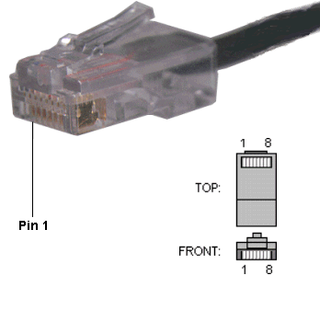
Network condition
1- two or more people are willing to share their data or resources, like printers
2- there should be a NOS (Network Operating System)
Like: Windows NT, 2000, Linux Fedora, Unix, Novel Netware
3- There should be media to connect two computers, such as a cable or wireless card and/or NIC
A computer network, often simply referred to as a network; it is a collection of hardware components and computers interconnected by communication channels that allow sharing of resources and information (wkpd)

Slide 4
Types of networks in terms of physical connection
LAN: Local Area Network
MAN: Metropolitan Area Network
WAN: Wide Are Network.
WLAN - Wireless Local Area Network
SAN - Storage Area Network, System Area Network, Server Area Network, or sometimes Small Area Network
CAN - Campus Area Network, Controller Area Network, or sometimes Cluster Area Network
PAN - Personal Area Network
DAN - Desk Area Network
Q?: What is a Sneaker Net?

Slide 5
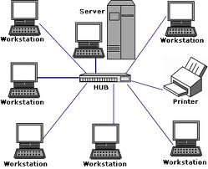
LAN network
What is a LAN?
When connecting two or more computers together within a building or a few close buildings.

Slide 6
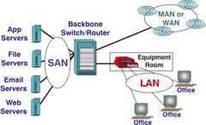
MAN Metropolitan Area Network
What is a MAN?
Connecting two or more computers within a city (up to 100 km) like Ottawa to Kanata

Slide 7
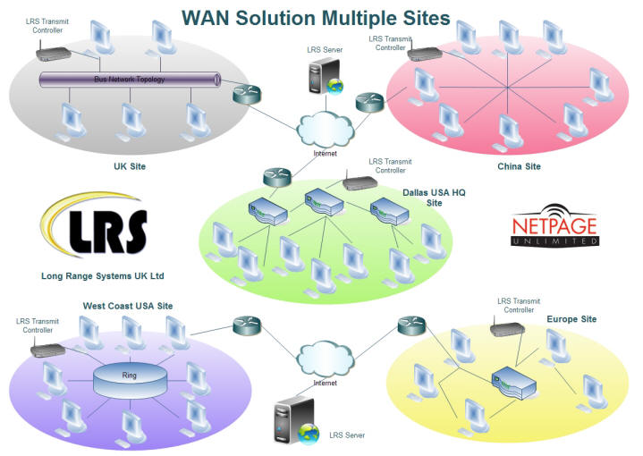
WAN Wide Area Network
What is a Wan?
Connecting two or more computers together more than 100 kilometers, city to city (Montreal to Ottawa), country to country (Canada and U.S.A.).

Slide 8
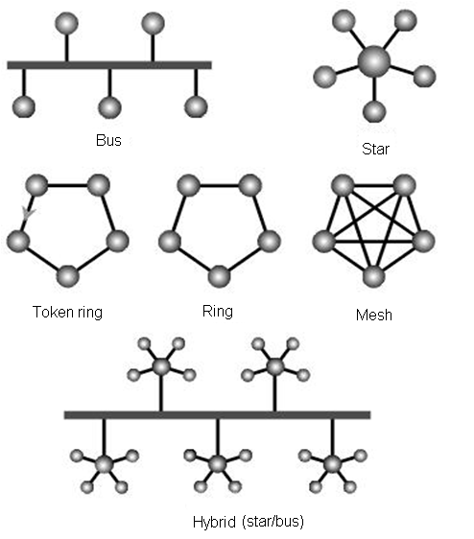
Network Topology. TYPES
What is Topology?
The physical layout of a network
Topology types
Bus
Star
Ring or token
Mesh
Hybrid (star/Bus)

Slide 9
Bus topology
A network setup where each of the computers and network devices are connected to a single cable or backbone
Advantages
Easy to implement and extend.
Well-suited for temporary or small networks not requiring high speeds (quick setup), resulting in faster networks.
Less expensive than other topologies
Cost effective; only a single cable is used.
Easy identification of cable faults.
Disadvantages
Limited cable length and number of stations.
If there is a problem with the cable, the entire network breaks down.
Maintenance costs may be higher in the long run.
Performance degrades as additional computers are added or on heavy traffic (shared bandwidth).
Proper termination is required (loop must be in closed path).

Slide 10
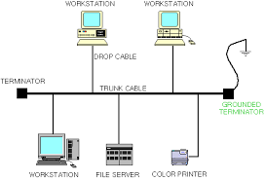
Bus topology thin net
Max 200 m
Minimum .5 m
Distance: two computers minimum .5 m
Distance : terminators maximum 200 m
Workstation number: 30 each segment

Slide 11
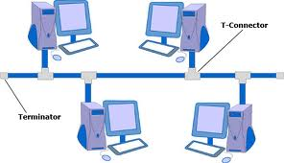
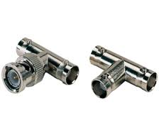
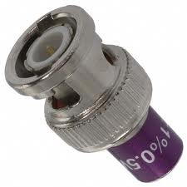
Bus topology types.
Thin net and Thick net networks
Thick net cable is good for backbones, while thin net cable is used for branch segments.
Thin net (10 base 2= 10 Mbps at 200 m)
Uses Thin coaxial cable
Uses Ethernet standard
Used T connector and Terminator.
30 computers per segment
First and the last computer should be Terminated
Distance between two computers
Maximum 200 meter,
Minimum, .5 meter
Hard troubleshooting

Slide 12
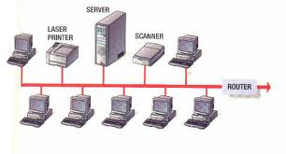
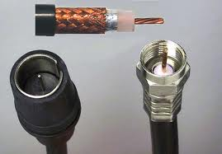
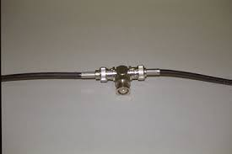
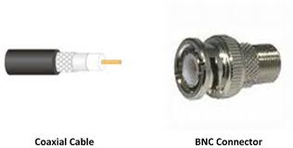

Bus (Thin net) 10 base2 topology parts
Bus Topology
Thin net coaxial cable
T connector
Terminator

Slide 13
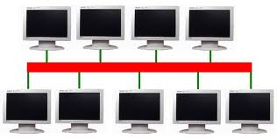
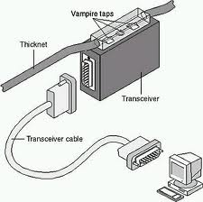
Bus Topology Thick net parts
Thick net (10 base 5)
Uses Thick net coaxial cable (back bone cable)
10 Mbps at 500 meter 100 computers per segment
Uses Ethernet standard
Distance between two computers:
Maximum 500 meters
Minimum 2.5 meter
Used vampire tab
Backbone cable

Slide 14
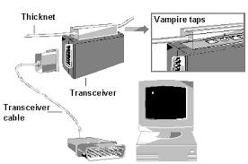
Thick net
2.5 m

Slide 15
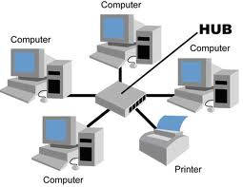
Star (10 Base T) topology
Star topology (10 Base T)
10 Mbps at 100 meter
Uses Ethernet standard
Uses RJ45 cable cat. 5
Uses Hub or Switch
Distance between computer and hub or switch is 100 meter
Maximum 100 computer per segment
Troubleshooting easy

Slide 16
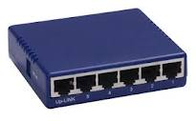
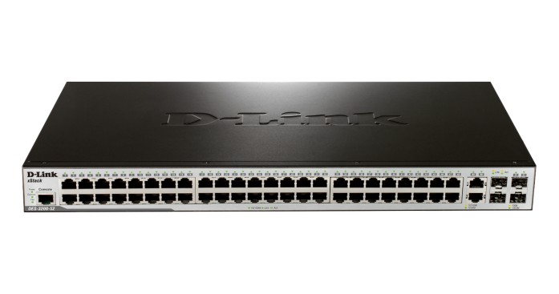
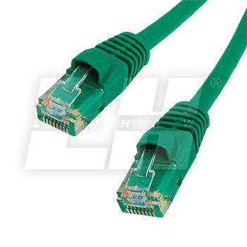
Star topology parts
Hub (switch)
A distributer device
- RJ45 cable (cat 5)
UTP (Unshielded Twisted Pair)
STP (Shielded Twisted Pair)
NOTE: This is not cat5 cable →

Slide 17
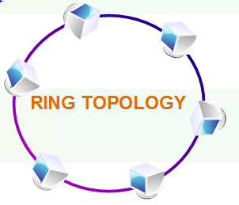
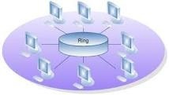
Ring topology
Computers connected to through a coaxial cable
A Token (signal) would through the computers
uses thin net coaxial cable
Uses Ethernet standard
Hard to troubleshoot
Classic Ring
Special Ring Hub

Slide 18
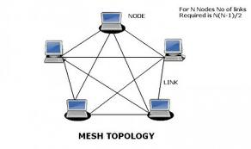
Mesh Topology
All computers are connected to each other
Uses thin net coaxial cable
Uses Ethernet standard
Node

Slide 19
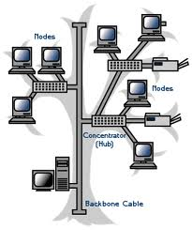
Hybrid (Star- Bus) topology
Mixed Star and Bus topology
Uses several hubs and a Thin net coaxial cable
Uses Ethernet standard

Slide 20
Ethernet
What is the Ethernet?
It is a standard (IEEE 802.3) that allows computers to communicate in a LAN network.
Developed by Robert Metcalf in 1980.
Characteristics:
Star: 10 base T, Hub, RJ 45 cable (Cat 5),
Bus: 10 Base 2 and 5, T connector, Terminator, coaxial cable.
Carrier Sense Multiple Access with Collision Detection (CSMA/CD)
Broadcast the signal

Slide 21
DNS Domain Name System
It is a hierarchical system (server, service) in a networking or Internet environment that resolves host name (computer name) or Domain name like microsoft.com to an IP address.
Example: microsoft.com to 192.168.0.1

Slide 22
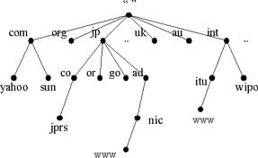
DNS structure
1- Root on top
3- Sub domain:
com, org, uk, au
2- Computer
1-microsoft.com

Slide 23
TCP/IP commands
*The Internet protocol suite is the set of communications protocols used for the Internet and other similar networks.
*Commonly known as TCP/IP ( Transmission Control Protocol / Internet Protocol )
*Were the first networking protocols defined in this standard

Slide 24
Workgroup peer to peer
a workgroup is a collection of computers on a local area network (LAN) that share common resources and responsibilities.
20 Computers
User is the administrator
No expansion
Cheap for a small company or home
Example: Windows, 3.11, 95, ME, XP, Windows NT clients

Slide 25
Domain client/server
Logical grouping of unlimited computers together.
Need a server
Need an administrator
Expensive network
Expansion allowed
Example: Windows NT, 2000, 2003, 2008, Unix

Slide 26

TCP/IP Protocol
Transmission Control Protocol/ Internet Protocol
(Internet protocol suite)
IP address: a unique identifying number for each machine connected to the Internet
IP addresses are normally expressed in decimal format as a "dotted decimal number”

Slide 27
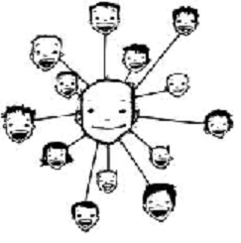
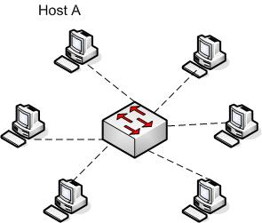
TCP/IP Protocol
-for humans-
Decimal 192. 168.0.1 (called octet)
-for machines-
Binary 11000000.10101000.00000000.00000001
1 2 3 4

Slide 28
Windows TCP/IP commands
ipconfig: shows the IP address of the host
ipconfig /all: shows the mac address, gate way, subnet mask
ping: Connects to another computer
hostname: shows the host name
tracert: show the number of hops (route)

Slide 29
Dynamic Host Configuration Protocol (DHCP)
It is a server that provides IP address.
With dynamic addressing, a device can have a different IP address every time it connects to the network

Slide 30
Wireless network
Benefits of wireless:
Mobility
Cost
Security
Convenient access
Easy to expand the network

Slide 31
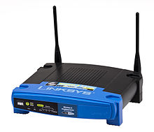
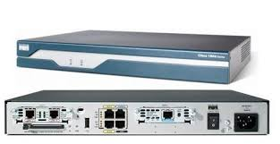
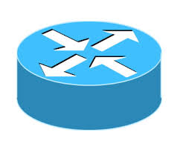
Router
have the ability to filter traffic, either incoming or outgoing, based on the IP addresses of senders and receivers.
Routers work with IP packets, meaning that it works at the level of the IP protocol.
Router symbol
Wireless router
Cisco router

Slide 32
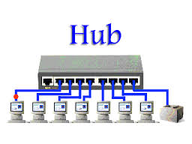
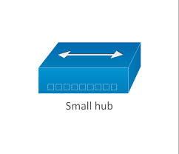
Hub
A common connection point for devices in a network. Hubs are commonly used to connect segments of a LAN.
Types: Intelligent and Passive Hubs
Hub symbol

Slide 33
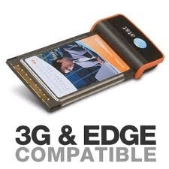
Wireless network parts
Computers should be capable of wireless technology
Access point (Router)
NOS

Slide 34
Wireless
A wireless network works with WAP (Wireless Access Point) through the WIFI.
WIFI connects devices like personal cell phones, MP3 & video game players and smart phones wirelessly to the internet by the WAP.
WAP has an access range of 20 meters (65 ft).
WIFI uses the IEEE 802.11 standard.
Over 700 million people are using the WIFI and there are more than 4 million Hotspots around world.
wireless encryption protocol (WEP) key

Slide 35
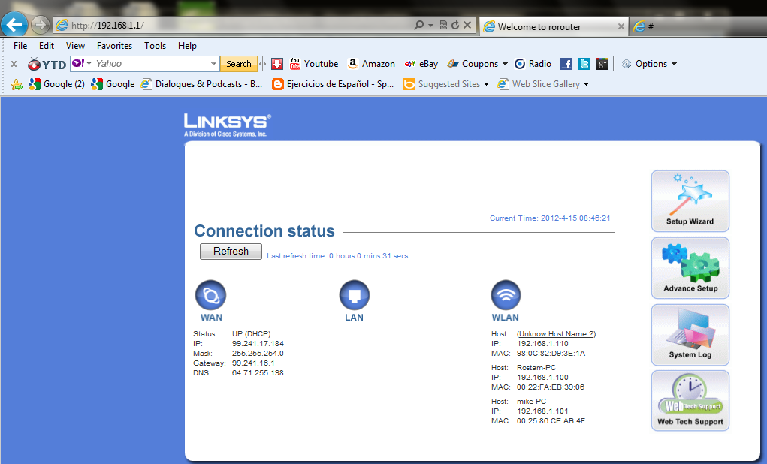
Router access 192.168.1.1

Slide 36
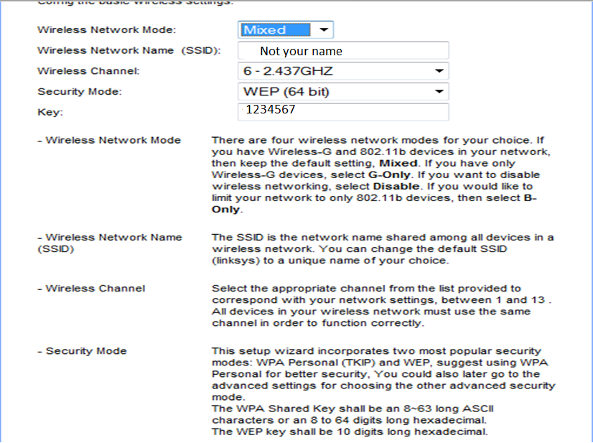
setting

Slide 37
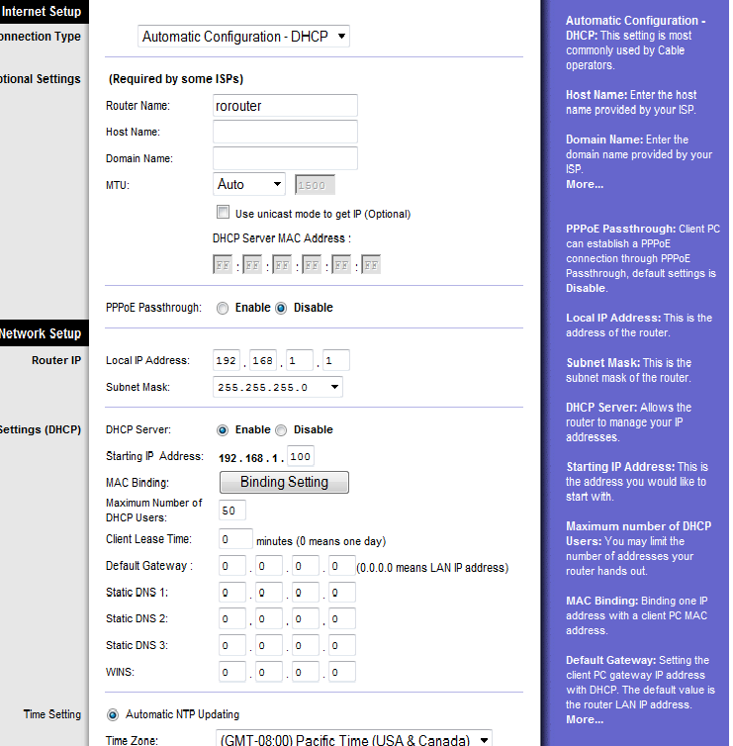

Slide 38
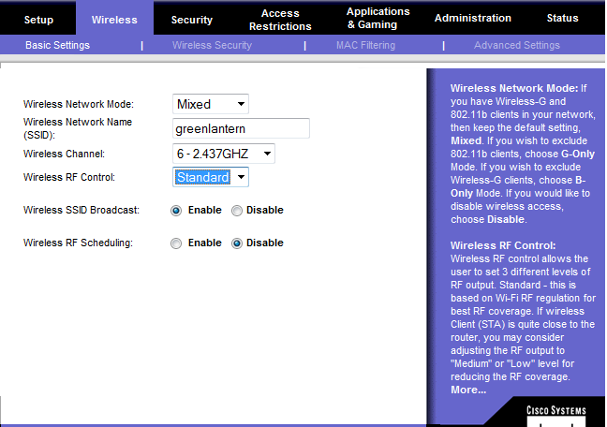
Wireless tab

Slide 39
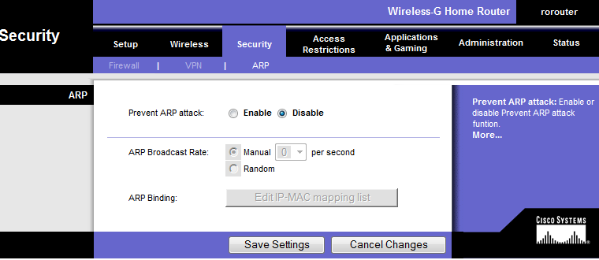
Security tab ARP: Short for Address Resolution Protocol, a network layer protocol

Slide 40
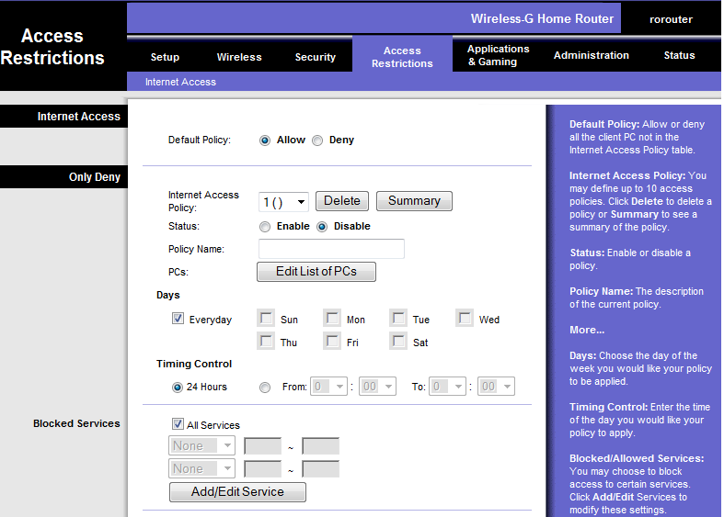
Access Restriction Tab

Slide 41
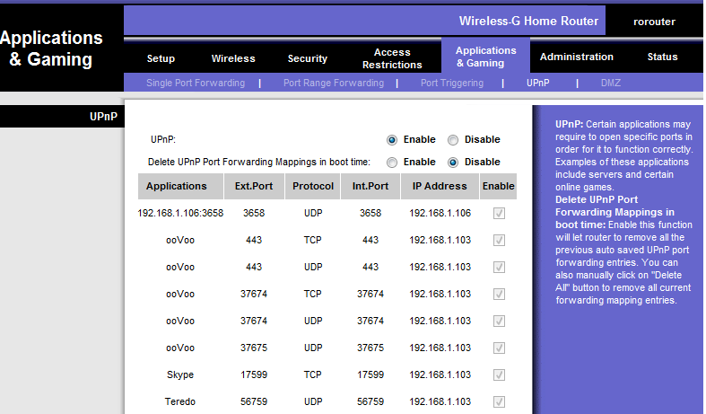
Application and gaming Upnp

Slide 42
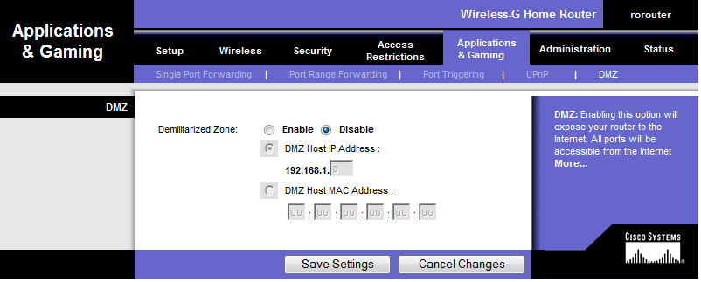
Application and gaming DMZ

Slide 43
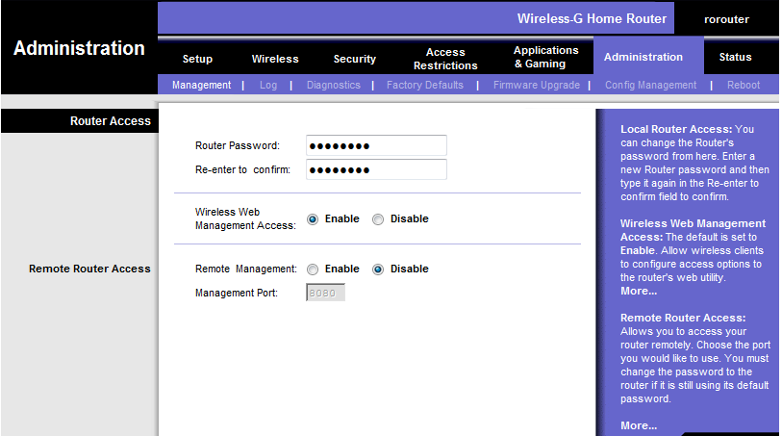
Administration

Slide 44
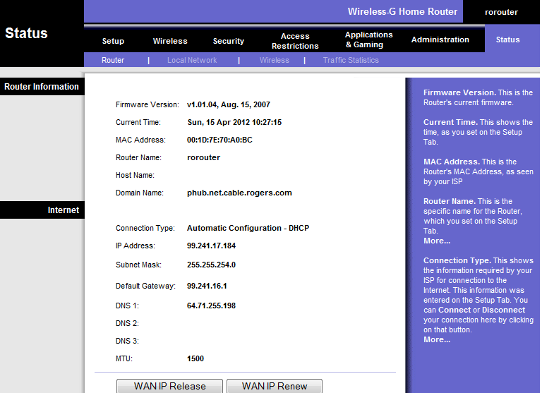
Statues

Slide 45
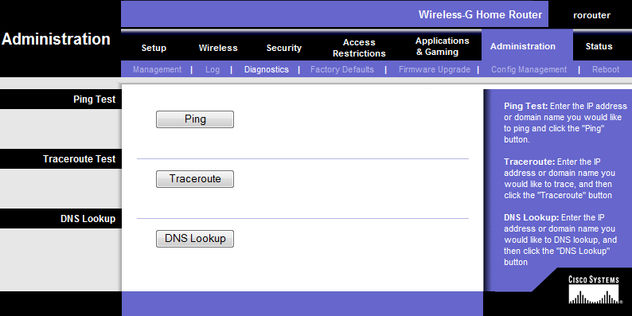
Administration Trace route

Slide 46
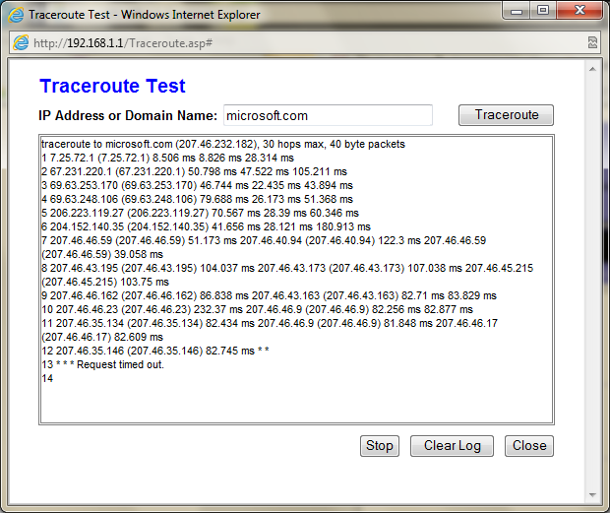
Administration Trace route

Slide 47
DSL
Digital Subscriber Line:
It is a digital technology that uses especial modem to connect a computer to the internet. The connection speed for DSL is 50 times faster than regular modem.
It allows multiple users share the bandwidth. The upstream for DSL is 1.5 to 9 Mbps and 16 to 640 Kbps to upstream data.

